Slide 1
LAKE JOSEPHINE
IMPROVEMENT ASSOCIATION
Annual Meeting
October 28th, 2019

Slide 2
Agenda
Introduction of Board Members
Welcome New Neighbors
2019: A Year in Review
2020 & Beyond
Fundraising & Financial Report
Help Protect Our Lake!

Slide 3
A year in review. . . 2019 Offshore Treatment Plan & Costs
Expected Treatment Plan
Actual Treatment Plan
Early Endothall treatment for Curly Leaf Pondweed + spot treatment(s) with 2,4-D for Eurasian Water Milfoil
Estimated Cost = $10K - $18K
Early Diquat Bromide treatment in two CLP- and EWM-infested sections of the lake. (11 acres total)
Actual Cost = $3.6K

Slide 4
2020 & Beyond
Estimated Treatment Costs
Item | Approx. Cost
Early CLP treatment w/ TBD herbicide (ideally one that will work on both CLP & EWM) | $5,000 - $15,000
Plant Survey (Free in past, but no future guarantee) | 0 - $1,300
Lake Delineation (Free in past, but no future guarantee) | 0 - $1,500
Veliger Testing (Free in past, but no future guarantee) | 0 - $1,500
DNR Grant | ???
Annual Website Fee | $550
TOTAL | $5,550 - $19,850

Slide 5
A year in review. . . 2019 Contribution Campaign
2019 Goals
How Did We Do?
100% contribution
$150/property
77% contribution level
$266/property
Your generosity is greatly appreciated!

Slide 6
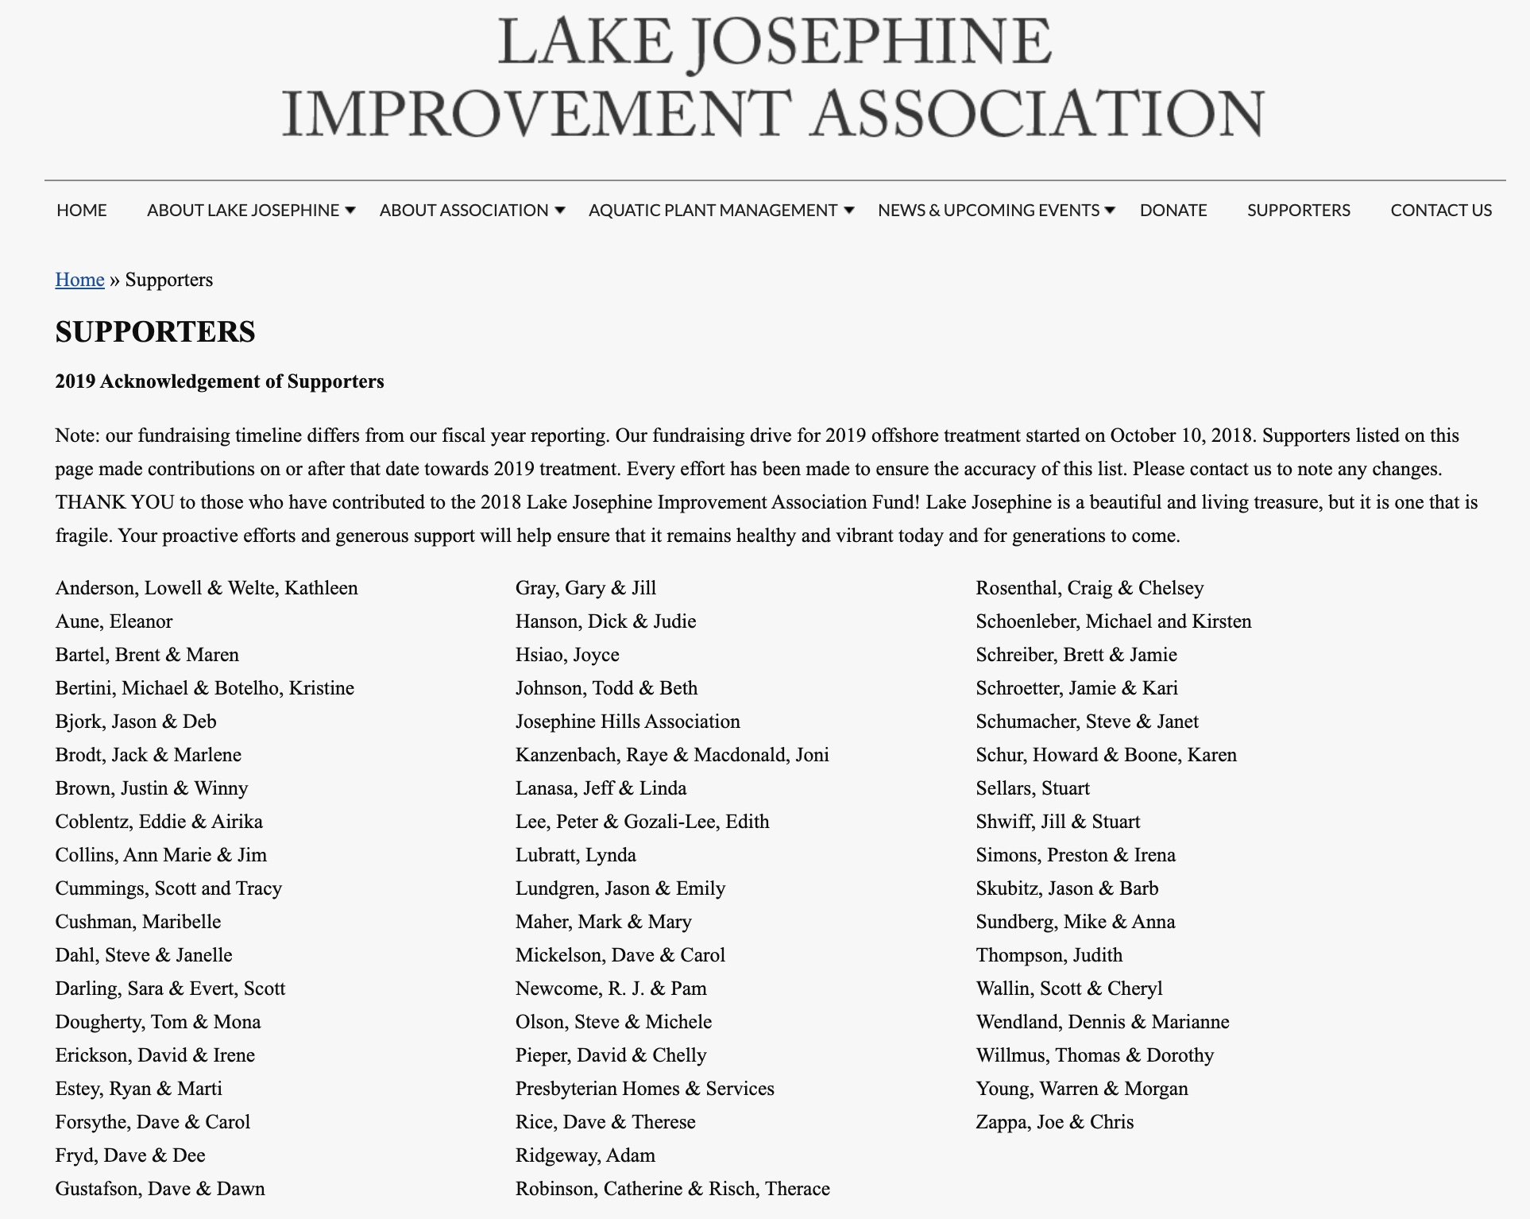
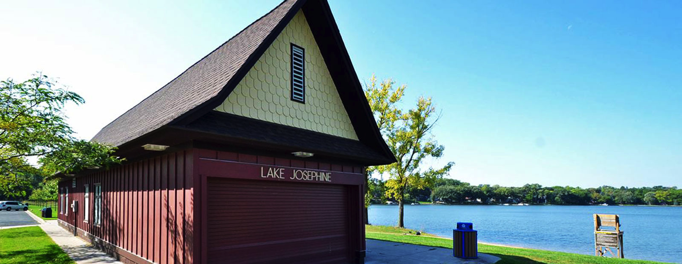
Thank You 2019 Season Contributors!

Slide 7
Contribution History
Season | 2015 | 2016 | 2017 | 2018 | 2019
Monies Raised | $11,300 + $2,300 DNR grant = $13,600 | $23,967 + $1,687 DNR grant = $25,654 | $25,032 + $1,200 DNR grant = $26,232 | $16,516 + No (0) DNR grant = $16,516 | $13,823 No (0) DNR grant = $13,823
Annual Ask | $125 | $350-$500 | $350-$500 | $150 | $150
Average Contribution | $208 | $443 | $472 | $312 | $266
Contribution Percentage | 79% | 79% | 78% | 78% | 77%
As we cannot predict the need for—or cost of—future treatments,
we are continuing with an annual “ask”.

Slide 8
Financial Reports
 | 2015 | 2016 | 2017 | 2018 | 2019 YTD
Year Starting Balance (as of start of fund- raising period) | $8,957.63 | $21,263.63 | $36,298.47 | $47,689.49 | $65,183.78
Expenses | $8,194.00 | $3,729.61 | $8,341.28 | $551.41 | $4,055.04
Income | $20,500.00 | $18,764.45 | $19,732.30 | $18,045.70 | $14,937.12
End-of-Year Balance (as of end of fund-raising period) | $21,263.63 | $36,298.47 | $47,689.49 | $65,183.78 | $76,383.12
End-of-Year Balances represent our Contingency Fund

Slide 9
2020 Contribution Campaign
Seeking $150 per property
Give as much or little as your situation allows
Any amount is appreciated!
LJIA is a 501(c)(3)--most donations are tax deductible
Consider corporate Matching Gift programs
Funds will be used towards 2020 treatment costs, remainder will be put towards contingency fund

Slide 10
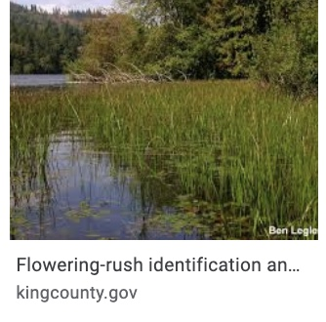
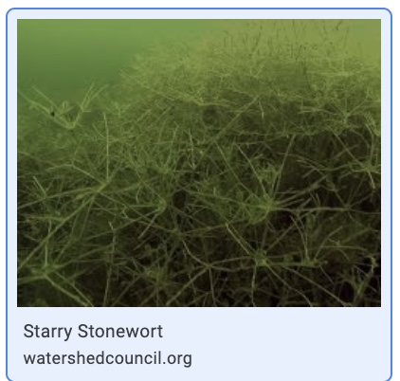
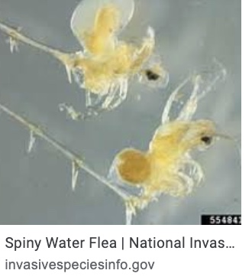
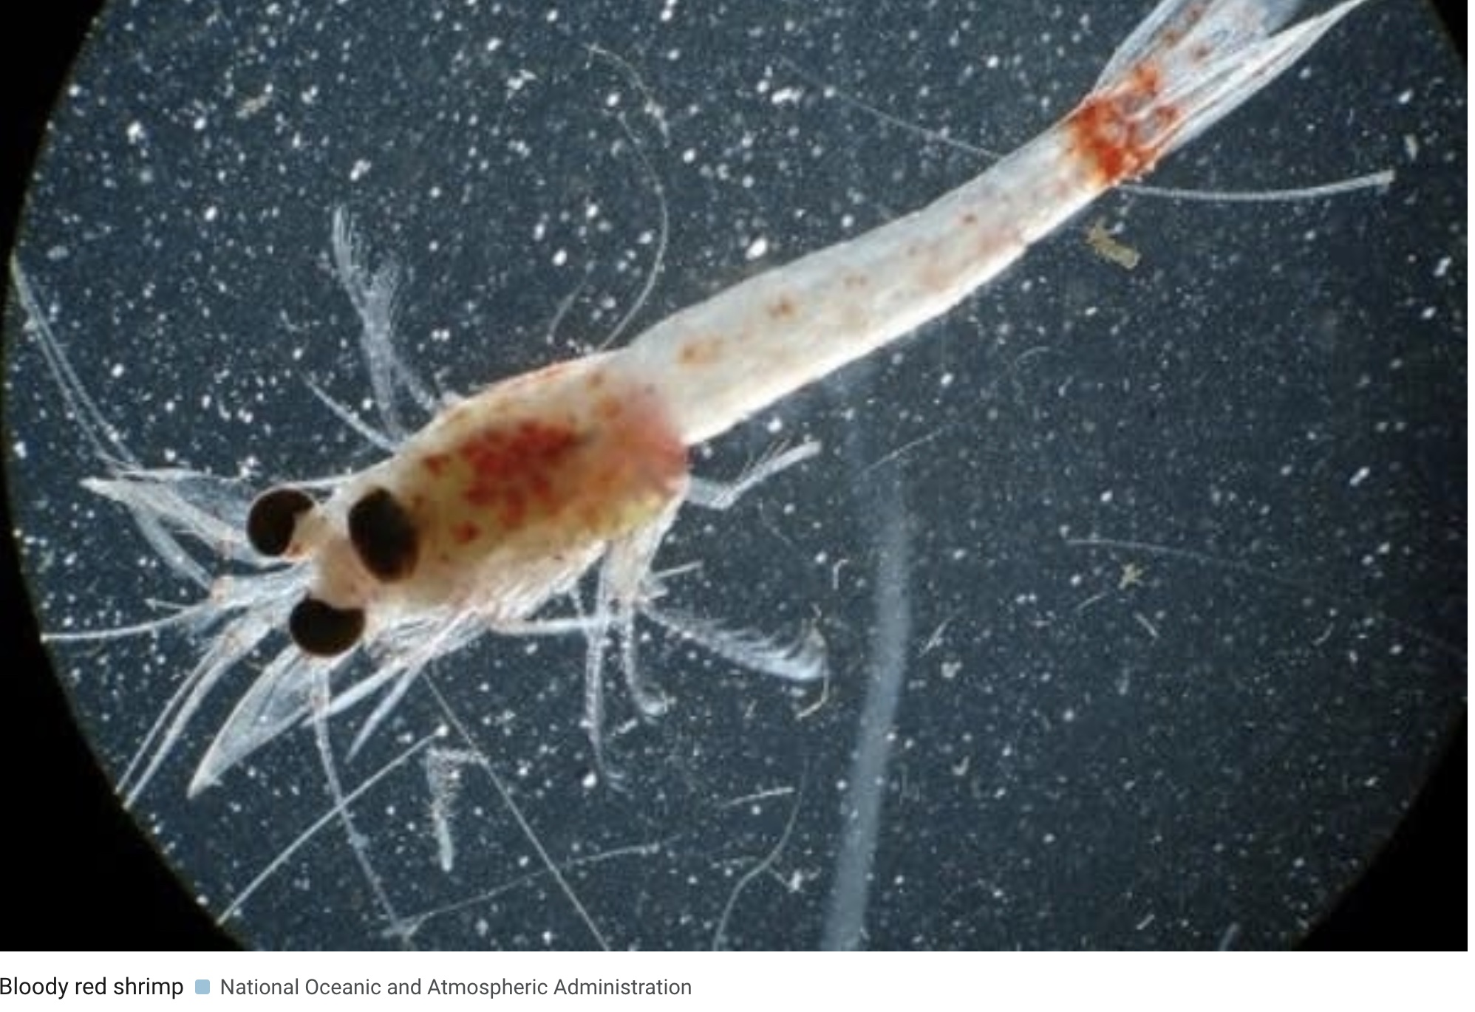
Why a Contingency Fund is Critical
Aquatic invasive species (AIS) remain a constant threat!
Five Ramsey County lakes now infested with Zebra Mussels
Other AIS close behind
Difficult to predict monitoring & treatment costs
Gratis services may dry up (~$4,500 received in 2019)
DNR grants to return, but amount unknown
No “silver bullet”— many treatments experimental
Left unchecked, AIS can destroy our lake’s ecosystem AND home values!
Flowering Rush
Starry Stonewort
Spiny Water Flea
Bloody Shrimp

Slide 11
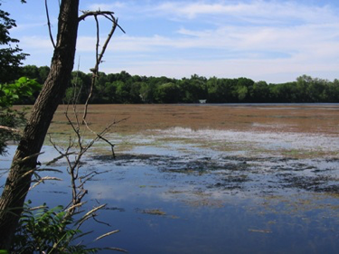
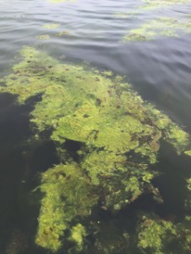
Which lake would you rather call home?
or

Slide 12
Why Early Detection is Important
The ability to treat is often inversely related to the degree of invasion.
Lake | Date ZM Detected | Nature of Invasion | Treatment Plan
White Bear | 9/2014 | Widespread | None USGS, MAISRC & DNR research ongoing
Bald Eagle | 8/2018 | Isolated Only one mussel found | Monitoring continues
Johanna | 8/2019 | Widespread | None
McCarron | 8/2019 | Widespread | None
Long | 9/2019 | Isolated Only one mussel found | Monitoring continues

Slide 13
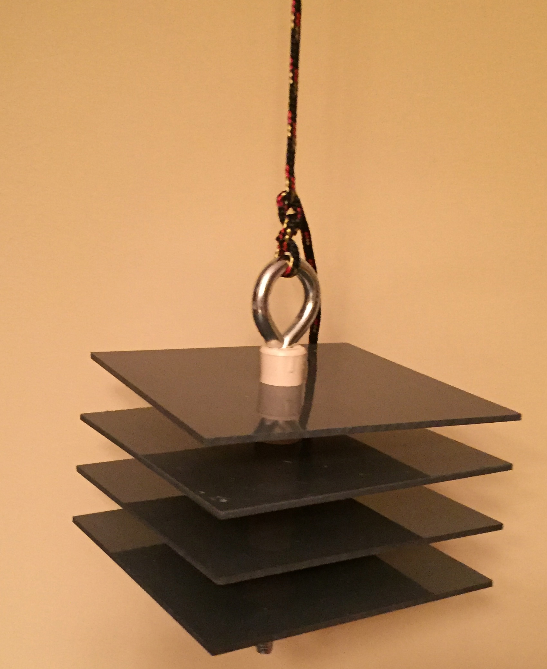
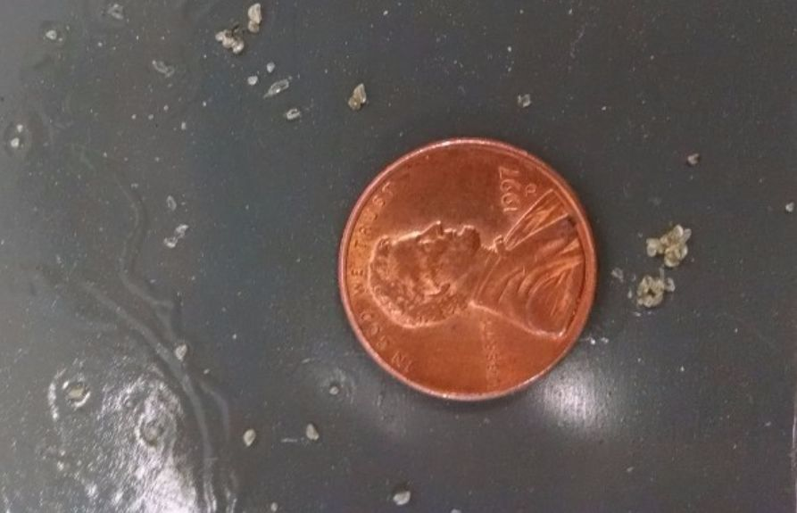
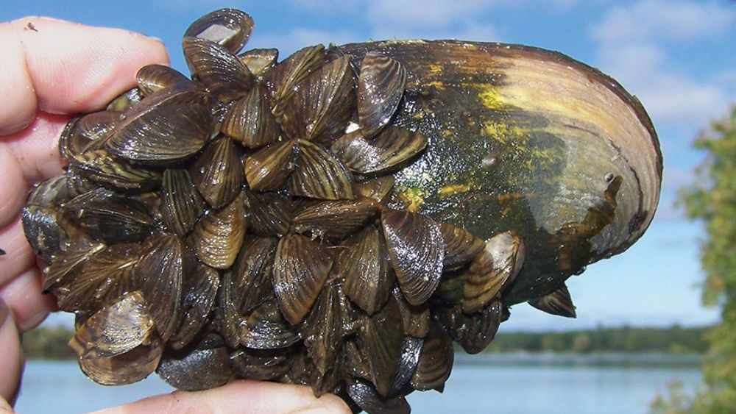
Stay vigilant!
Check your docks and Zebra Mussel sample plates
Contact Brett Schreiber @ 651-324-0042 if you find anything suspicious
Adopt & promote best practices to prevent AIS spread
Remove plants/vegetation from boats
Drain boats, live wells and bait wells
Dispose of unwanted bait in the trash
Allow transferred docks & other equipment to dry for 21 days

Slide 14
Thank You for your support & engagement!
Please submit your 2020 contribution at the back table
Double-check your contact info
Ask to get more involved in LJIA committees & events
Join us immediately after the meeting! The Tavern Grill (corner of Lexington Ave. N & Cty E)
Don’t miss Winter Blast in early 2020--date TBD

