Slide 1
LAKE JOSEPHINE
IMPROVEMENT ASSOCIATION
FINANCIAL REPORT
CONTRIBUTION HISTORY & FUTURE NEED

Slide 2
Financial Reports
2014 Summary
Beginning of year Balance: $7,758.63
Expenses (weed treatment) $6,426.00
Income $7,625.00
End of Year Balance $8,957.63
2015 Summary
(as of 10/19/2015)
Beginning of year Balance: $8,957.63
Expenses (weed treatment) $8,194.00
Income $7,425.00
End of Year Balance $8,188.63

Slide 3
Contribution History
In late 2012, Lake Josephine was diagnosed with Eurasian Water Milfoil (EWM).
For the first time in Fall of 2013, the Board sought a voluntary contribution from lake homeowners to cover 2014 offshore EWM treatment.
2014 Season
2015 Season
20.4 acres EWM Offshore Treatment = $6,426 Total Cost
Monies Raised
$5,625 Donations + $1000 DNR Grant = $6,525
$127 = average contribution/property
63% lakeshore properties contributed
Note: We treated EWM 15% beyond the littoral limit, which was more than 2.5 times our normal allowance of 7.9 acres.
24.1 acres EWM Offshore Treatment = $8,194 Total Cost
Monies Raised
$11,300 Donations + $2,300 DNR Grant = $13,600
$208 = average contribution/property
79% lakeshore properties contributed
Note: Donations equals a total of all collections, not just lakeshore. These figures are based on a seasonal contribution cycle vs. fiscal year reporting.
In the fall of 2014, the board began to discuss a more pro-active approach & the need to build a fund in-advance of the spring season.

Slide 4
Contribution History
In late 2012, Lake Josephine was diagnosed with Eurasian Water Milfoil (EWM).
For the first time in Fall of 2013, the Board sought a voluntary contribution from lake homeowners to cover 2014 offshore EWM treatment.
2014 Season
2015 Season
20.4 acres EWM Offshore Treatment = $6,426 Total Cost
Monies Raised
$5,625 Donations + $1000 DNR Grant = $6,525
$127 = average contribution/property
63% lakeshore properties contributed
Note: We treated EWM 15% beyond the littoral limit, which was more than 2.5 times our normal allowance of 7.9 acres.
24.1 acres EWM Offshore Treatment = $8,194 Total Cost
Monies Raised
$11,300 Donations + $2,300 DNR Grant = $13,600
$208 = average contribution/property
79% lakeshore properties contributed
Note: Donations equals a total of all collections, not just lakeshore. These figures are based on a contribution cycle vs. calendar/fiscal year reporting.
Good News
We had a big jump in participation
THANK YOU!
In the fall of 2014, the board began to discuss a more pro-active approach & the need to build a fund in-advance of the spring season.

Slide 5
Contribution History
In late 2012, Lake Josephine was diagnosed with Eurasian Water Milfoil (EWM).
For the first time in Fall of 2013, the Board sought a voluntary contribution from lake homeowners to cover 2014 offshore EWM treatment.
2014 Season
2015 Season
20.4 acres EWM Offshore Treatment = $6,426 Total Cost
Monies Raised
$5,625 Donations + $1000 DNR Grant = $6,525
$127 = average contribution/property
63% lakeshore properties contributed
Note: We treated EWM 15% beyond the littoral limit, which was more than 2.5 times our normal allowance of 7.9 acres.
24.1 acres EWM Offshore Treatment = $8,194 Total Cost
Monies Raised
$11,300 Donations + $2,300 DNR Grant = $13,600
$208 = average contribution/property
79% lakeshore properties contributed
Note: Donations equals a total of all collections, not just lakeshore. These figures are based on a contribution cycle vs. calendar/fiscal year reporting.
Bad News
Our weed problem grew in 2015
AND
so did our cost to treat.
In the fall of 2014, the board began to discuss a more pro-active approach & the need to build a fund in-advance of the spring season.

Slide 6
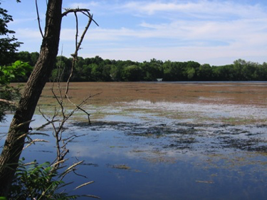
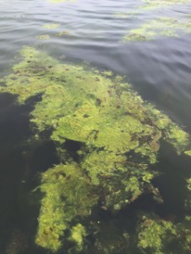
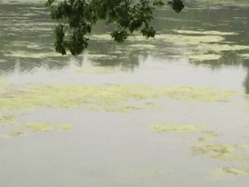
Future Considerations
Eurasian water milfoil is an infestation that CANNOT be eradicated,
it can only be controlled.
Annual DNR Permit & Variance Approval
Plant Survey + Lake Vegetation Management Plan
$1,000-3,000 - Approximate Annual Cost
DNR grants we’ve relied on in the past are drying up
We have only treated EWM in the past, but we have other bothersome weeds that we could be addressing IF we had funds:
Curley Leaf Pondweed – leaves thick stalks in the water even after it is killed.
Filamentous Algae – creates an oily slick that floats on the surface of the water.
Treatment costs may continue to grow IF our infestations grow and/or we need to change up herbicides, as weeds become resistance.
We need to start building a contingency fund to protect against a catastrophic event such as Zebra Mussel infestation.
Notes:
ZM Talking point:
The ability to treat ZM effectively is completely predicated on being able to treat them as soon as the infestation is spotted, and that treatment is predicated on us having the funding already in place.

Slide 7
2016 & Beyond
Management Options & Associated Costs
Lake Vegetation Management Plan = $1,000 (board negotiated)
Plant Survey = $3,000 (board negotiated)
Early CLP Treatment: $253/acre x 20 acres = $5,060
Initial EWM Treatment: $340/acre x 26 acres = $8,840
Second spot EWM Treatment: $340/acre x 5 acres = $1,700
Assume NO DNR grant = $0
2016 TREATMENT NEED: $15,600
Additional Considerations:
Algae Treatment: $244/acre x 10 acres = $2,440
Need to build a future contingency fund
Early Treatment Required for Zebra Mussels = $500/acre x 10 acres = $5,000
TOTAL TREATMENT ESTIMATE: $23,040

Slide 8
2016 & Beyond
Management Options & Associated Costs
What more can you do?
CONTRIBUTE
Plant Survey = $3,000
Early CLP Treatment: $253/acre x 20 acres = $5,060
Initial EWM Treatment: $340/acre x 26 acres = $8,840
Second spot EWM Treatment: $340/acre x 5 acres = $1,700
Assume NO DNR grant = $0
2016 TREATMENT NEED: $18,600
Additional Considerations:
Algae Treatment: $244/acre x 10 acres = $2,440
Need to build a future contingency fund
Early Treatment Required for Zebra Mussels = $450-550/acre x 10 acres = $5,500
TOTAL TREATMENT ESTIMATE: $26,540

Slide 9
2016 Contribution Campaign
Offshore Treatment
Who?
Seeking 100% participation of lakeshore properties
Seeking offshore & access neighborhood participation too
When?
NOW… To best prepare for the 2016 summer season, we need to ensure sufficient funding for either treatment option & the additional considerations
Why?
Future revenue sources are not expected to keep pace with expenses for ongoing treatments.
How much?
As much as you can…we commit to treating the best we can with funds collected!
Ideal 2016 Treatment Estimates:
$15,600-$23,040 = $350-$500/property*
<$1-$1.40/day
Every little bit helps!
*Assumes ~70% participation
Notes:
41 properties (61%) was the original contribution percentage vs. 53 (79%) final 2015 property contribution %
So, we split the difference at approx. 70% = $350-$500/property.
We hope you prove us wrong…anything extra will go towards our future treatment efforts/fund.

Slide 10
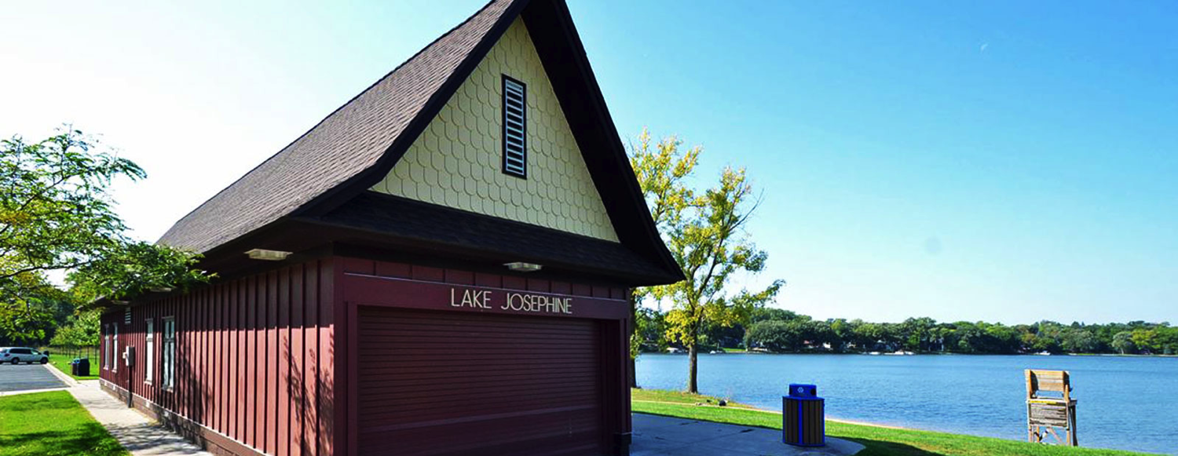
Thank You 2015 Season Contributors
Arsenault, Paul & Jeanne
Aune, Eleanor
Bauer, Wally
Boeck, Rob & Cathleen
Bradley, Hugh & Karla
Coblentz, Eddie & Airika
Collins, Ann Marie & Jim
Cummings, Scott & Tracy
Cushman, Maribelle
Dahl, Steve & Janelle
Dougherty, Tom & Mona
Erickson, David & Iren
Estey, Ryan & Marti
Fryd, Dave & Dee
Gray, Gary & Jill
Gustafson, Dave & Dawn
Hamburger, John & Jill
Hanson, Dick & Judie
Hoivik, Tom
Hsiao, Joyce
Johnson, Mark & Penny
Johnson, Todd & Beth
Josephine Hills Association
Kadrie, Chuck & Gert
Kanzenbach, Raye & MacDonald, Joni
Kucera, Emil & Angie
Lanasa, Jeff & Linda
Lubratt, Lynda
Mahler, Mark & Mary
Manos, Jeri
Mickelson, David & Carol
Newcome, R. J. & Pam
Pieper, David & Cheleen
Presbyterian Homes & Services
Rekuski, Frank
Rice, Dave & Therese
Robinson, Amy & Kurt
Robinson, Catherine & Risch, Therace
Scheller, John & Stacy
Schoenleber, Mike & Kirsten
Schreiber, Brett & Jamie
Schultz, Rick & Amy
Schumacher, Elizabeth
Schumacher, Steve & Jane
Schur, Howard & Boone, Karen
Sellars, Stuart & Carol
Sheehan, Barbie
Shwiff, Jill & Stuart
Solberg, Arlyn
Thompson, Judy & Dick
Wallin, Scott & Cheryl
Welte, Kathleen & Anderson, Lowell Woodburn, Bob & Sally
Young, Warren & Morgan
Zappa, Joe & Chris

Slide 11
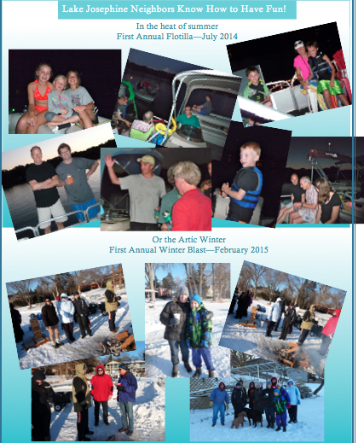
Membership has its privileges!

Slide 12
Thank You for Your Engagement!
Before You Leave
Please double-check your contact info at entry desk
Complete the volunteer form at your table
If you’re prepared to submit your 2016 contribution, please see any Board member
After Meeting
Share recap with neighbors who may have missed meeting
Visit our new website: http://lakejosephineimprovementassociation.com/

